Slide 1
Critical Thinking Skills
Lecture 3 the Language of Arguments

Slide 2
Last Lecture
An argument is a connected series of statements that are intended to give reasons of some kind for statement.
An argument must be consisted of premises and conclusion.
Arguments are not the same as reports, conditional statements, illustrations, unsupported statements and explanations.

Slide 3
Learning Outcomes
Language Pitfalls
Unclear / Precision
Definition
Vague
Over-generality
Ambiguous
Types
Strategies
Words
Denotation
Connotation
To know some aspects in the usage of language.
To know the precision in the usage of language.
To know the nature of definition.

Slide 4
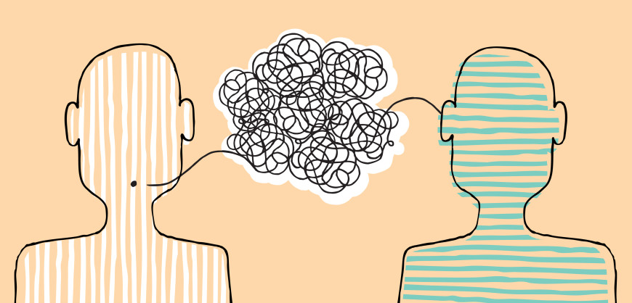
Problems of Language
The functions of language:
To communicate with others
To know the world
To manipulate / influence
Malfunctions:
Confusion
Biased
Misunderstanding
Misleading

Slide 5
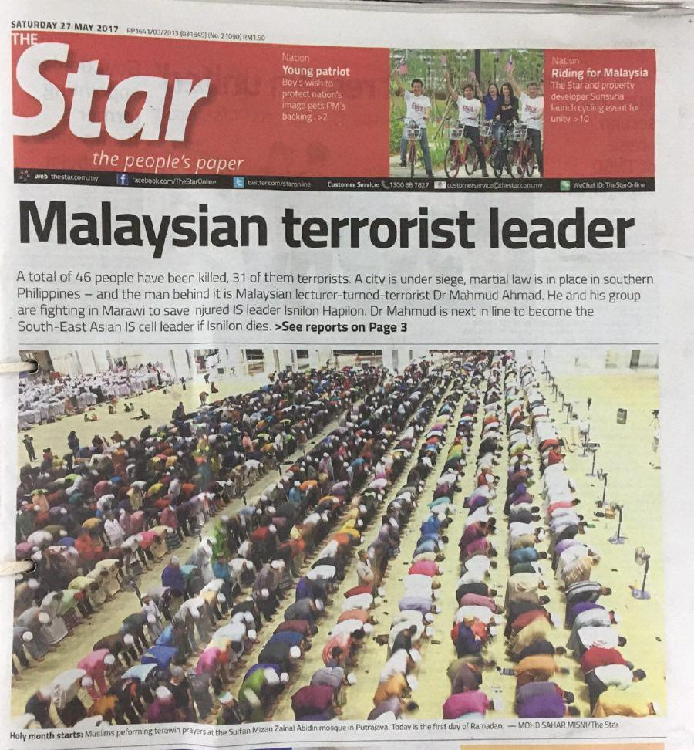
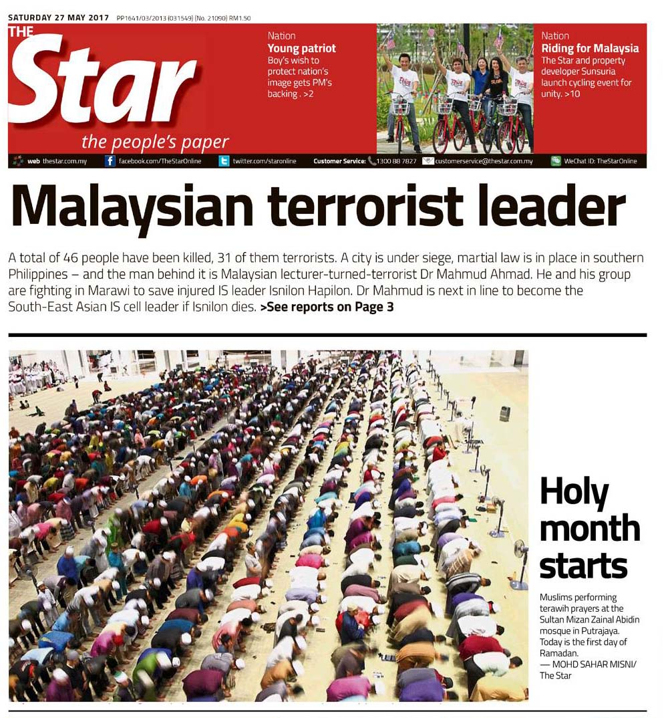

Slide 6
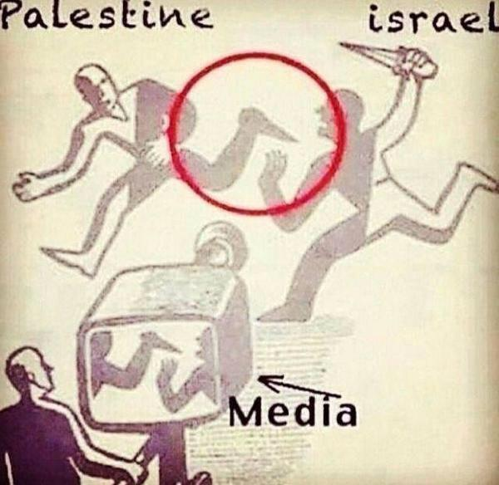
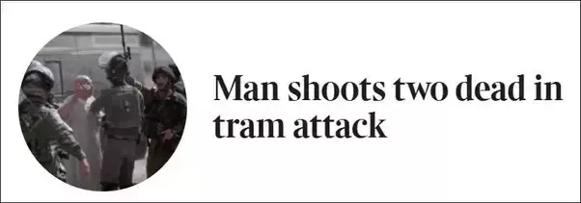
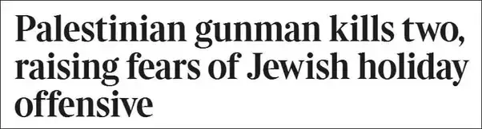
News Healines
Reuters:
Israeli soldier shoots dead Palestinian driver in West Bank: army
Palestinian who stabbed Israeli soldier shot dead: army
The Sunday Times:

Slide 7
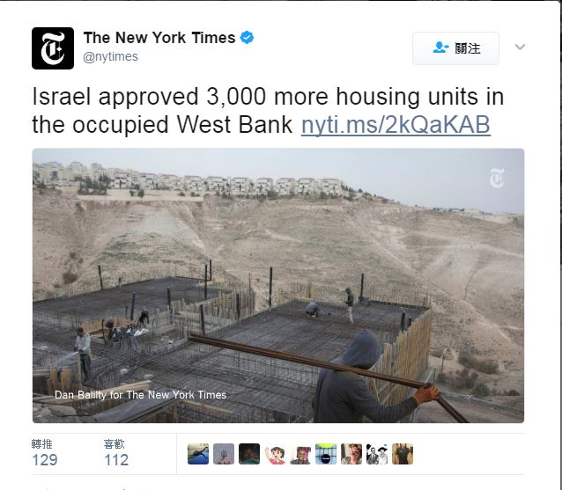
New York Times (1st February 2017)
Israel approved 3,000 more housing units in the occupied West Bank late Tuesday, the largest number in a wave of new construction plans that defy the international community and that open a forceful phase in the country’s expansion into land the Palestinians claim for a future state.

Slide 8
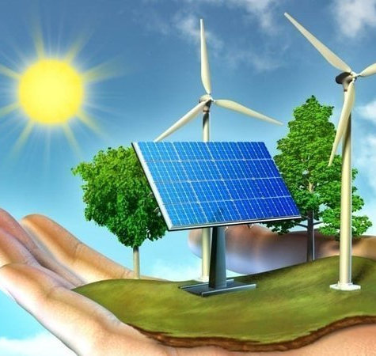
Language in the arguments
P: Since energy neither comes into being nor goes out of being.
C: There should not be an energy crisis.
P1: The natural resources are quick of depletion.
P2: The world population is growing.
C: Therefore, we should colonize Mars.

Slide 9
Problems of Language
Can a language or expression reflect a viewpoint (argument) accurately or precisely?

Slide 10
Unclear Meaning and Precision
Vagueness, Over-generality and Ambiguity

Slide 11
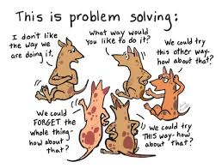
Precision
The obstacles to precision:
Vagueness
Ambiguity
Over-generality
Make it precise!!

Slide 12
Precision
Vagueness:
Having imprecise boundary.
Meaning is fuzzy or inexact in given context.
Give rise to unclear borderline cases
Blurry boundaries and unclear borderline application
That is good!
Your article is good and original.
He is tall.
Extremely
Moderately
Precise
Three men and two women were hurt in the car accident.
A few men and women were hurt in the car accident.
A few people were hurt in the car accident.

Slide 13
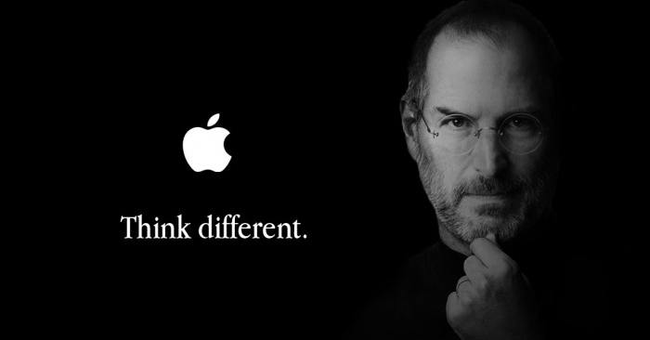

Precision
Advantages of Vagueness:
Suitable caution:
I think I did pretty well on the exam.
Add richness, subtlety, complexity:
Think different! Impossible is nothing!
Avoid revealing important information
“We will make the US fully accountable for the catastrophic consequences that may be brought about by its high-handed and outrageous acts”

Slide 14
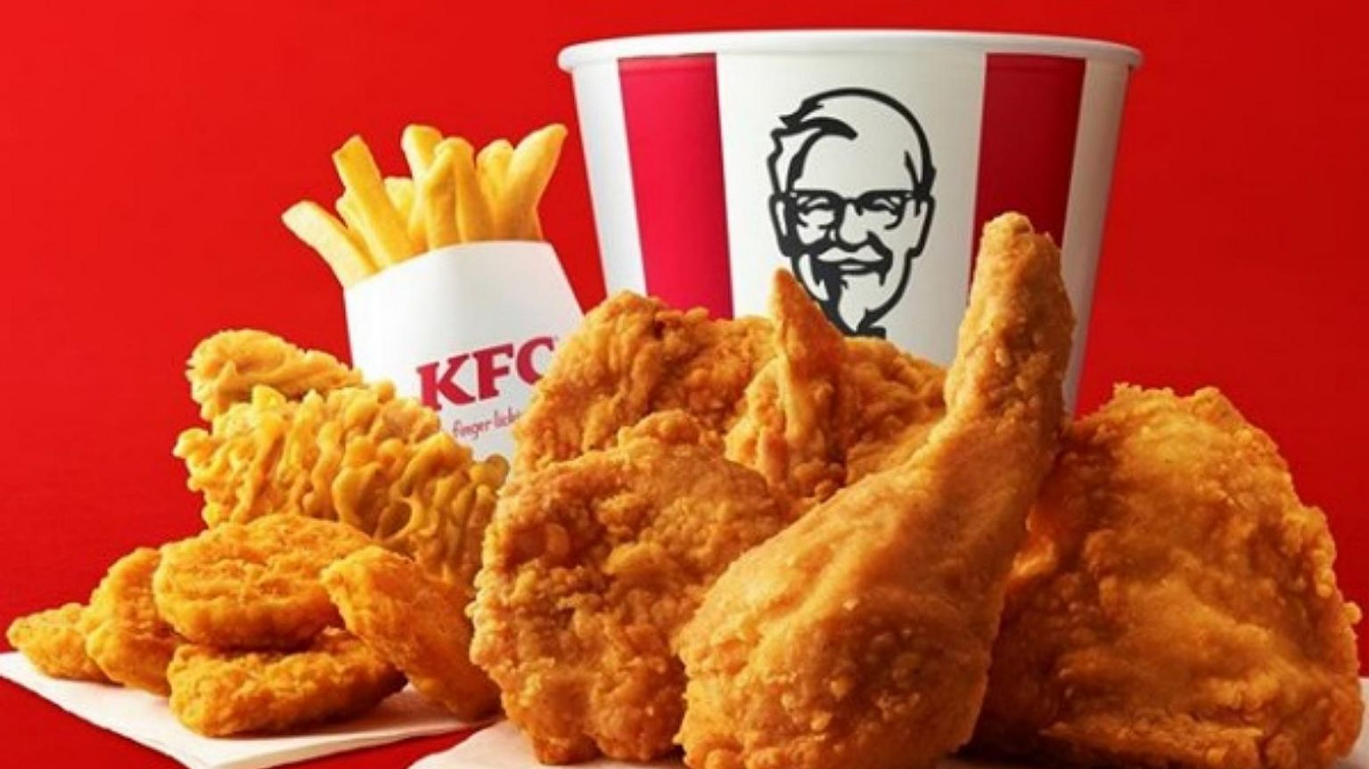
Precision
Over-generality:
Too broad and unspecific enough in a given context
Not borderline cases
Q: How old are you?
A: More than 20 years old!
Q: What is the best selling in KFC?
A: Fried Chicken.

Slide 15
Vagueness and Over-generality
 | Vagueness | Over-generality | Precise
How old are you? | So young! | More than 15 | 20 years old
How many students take this subject? | No less | Around 100 | 154 students
When will you complete the work? | Soon | By next week | on Monday

Slide 16
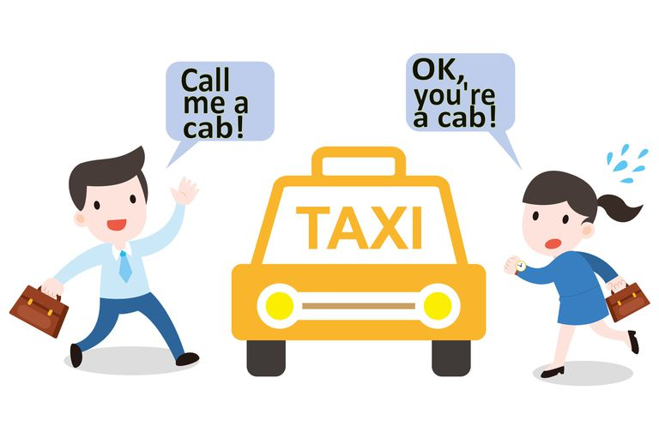
Precision
Ambiguity:
A word has two or more distinct meanings in the language.
The context does not make clear which meaning is intended
Examples:
Bank, Japanese teacher, bachelor, light, etc.

Slide 17

Precision
Semantic Ambiguity
Uncertainty about the meaning
I will go to bank.
Syntactical Ambiguity
Faulty grammar or word order
Mr. Tan will give a lecture on money game in the classroom.
The Japanese teacher is looking for you.
Referential Ambiguity
Unclear on what a pronoun or object is referring to
He will finish his job.
John saw Mike on the roof with a telescope.
John hit Mike with his phone. Then he died.

Slide 18
Definition
Avoiding imprecise and misleading

Slide 19
Definition
Why does definition matter?
To avoid any misunderstanding and misleading.
To overcome any usage of unprecise words, phrases or sentences..
To provide a clear and accurate language for a convincing argument.
We cannot assume people have the same conception and understanding, and similar background with us!! So, precise language does matter!

Slide 20
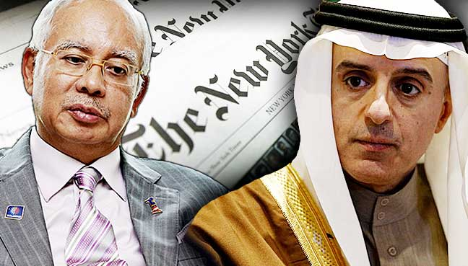
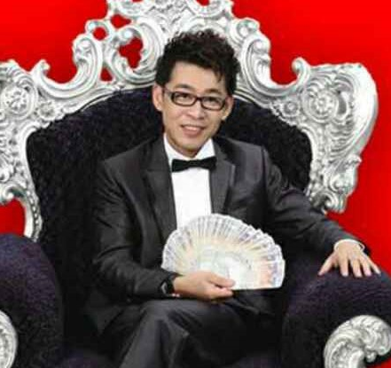
Definition
Donation?
Bribe?
Corruption?
What is donation?
Saudi Arabia said that $681m transferred into Malaysia Prime Minister Najib Razak’s personal bank account was a genuine donation.
Money game companies have exploited charity and education to whitewash their crimes. Even though the school directors were well aware of what Zhang Jian had done, they still willingly accepted his donation.
Donation?
Whitewashing?
Laundry?

Slide 21
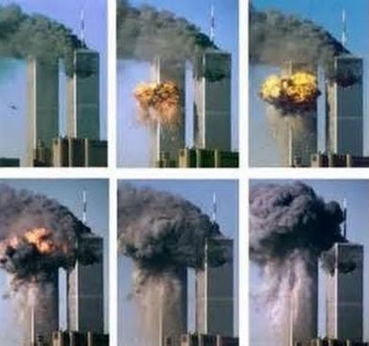
A definition worth US$7 Billion
On September 11,2001, terrorists destroyed the twin towers of the World Trade Center in New York City by crashing two planes into them. At the time, Larry Silverstein was holding a 99-year lease for the buildings.
The buildings were covered by insurance which would pay US$3.55 billion for an "occurrence" of a terrorist attack. Obviously, the insurers claimed this was just one occurrence of a coordinated attack. But Silverstein argued that he should get double the amount, because there were two occurrences of attacks, as there were two planes that hit the buildings about 15 minutes apart.

Slide 22

Tips for constructing a good definition
(1) convey the essential meaning (not too broad or too narrow)
(2) provide a context for ambiguous words
(3) avoid figurative, obscurity and circularity
(4) use credible resources (lexical, acknowledged or academic)
Human:
1. Humans are two-legged animals.
2. Humans are religious animals.
3. Humans are animals full with love.
4. Humans are homo sapiens.
5. Humans are rational animals.

Slide 23
Concluding Remarks
A word (or group of words) is vague when its meaning is fuzzy and inexact.
A word is over general if it is too broad and unspecific in a given context.
A word or expression is ambiguous if it has two or more distinct meanings and the context does not make clear which meaning is intended.
A simple way to avoid unclear and imprecise words is to provide definition.

